Slide 1
Cloud Computing
SEWP ZG527

Slide 2

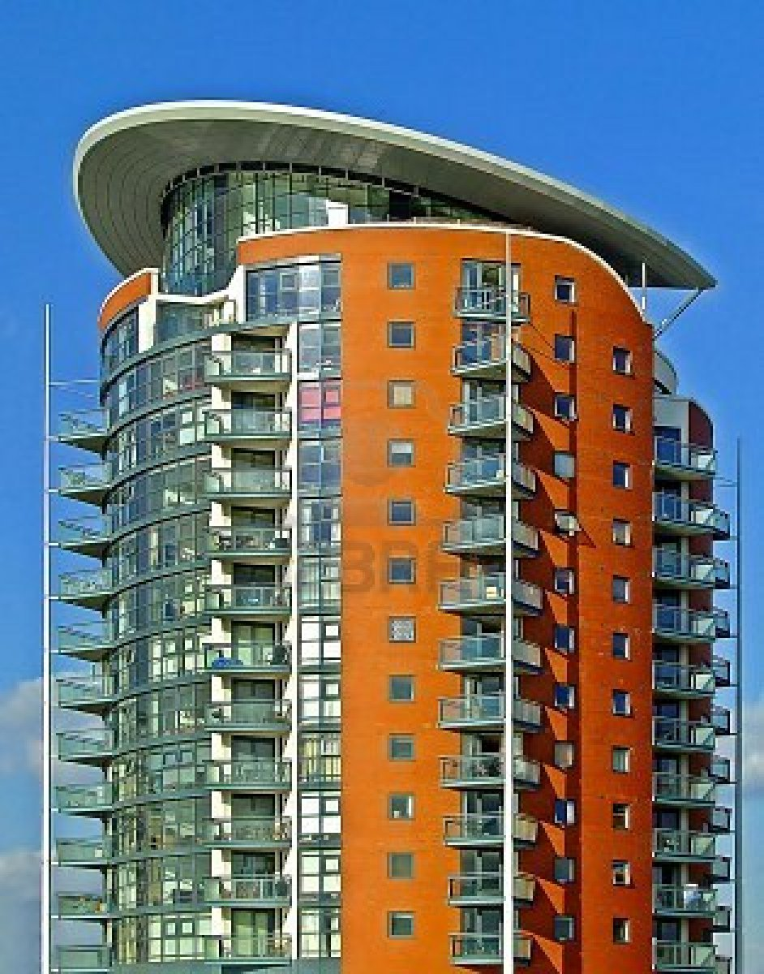
Multitenancy – What is it?
Notes:
RL 7.2
http://www.rightscale.com/blog/enterprise-cloud-strategies/four-steps-achieving-high-availability-cloud

Slide 3
Pros and Cons
 | House | Apartment
Effective use of land | - | +
Privacy | + | -
Infrastructure sharing | - | +
Maintenance cost sharing | - | +
Freedom | + | -
House: Privacy and freedom
Apartment: Cost efficiency
Notes:
http://www.rightscale.com/blog/enterprise-cloud-strategies/four-steps-achieving-high-availability-cloud

Slide 4
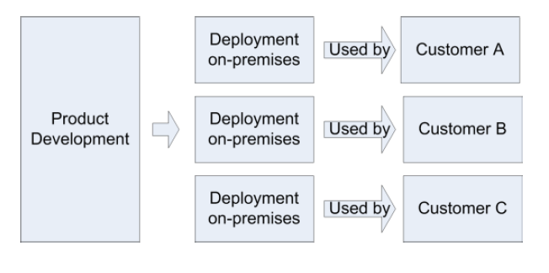
Traditional Deployment Model
Notes:
http://www.rightscale.com/blog/enterprise-cloud-strategies/four-steps-achieving-high-availability-cloud

Slide 5
Multitenancy – Introduction
Multi-tenancy is an architecture in which a single instance of a software application serves multiple customers. Each customer is called a tenant. Tenants may be given the ability to customize some parts of the application, such as color of the user interface (UI) or business rules, but they cannot customize the application's code.
A software-as-a-service (SaaS) provider, for example, can run one instance of its application on one instance of a database and provide web access to multiple customers. In such a scenario, each tenant's data is isolated and remains invisible to other tenants.
Notes:
http://www.rightscale.com/blog/enterprise-cloud-strategies/four-steps-achieving-high-availability-cloud

Slide 6
Multitenancy – Introduction
Multi-tenancy is an architectural pattern
A single instance of the software is run on the service provider’s infrastructure
Multiple tenants access the same instance.
In contrast to the multi-user model, multi-tenancy requires customizing the single instance according to the multi-faceted requirements of many tenants.

Slide 7
Multitenancy – key aspects
A Multi-tenants application lets customers (tenants) share the same hardware resources, by offering them one shared application and database instance ,while allowing them to configure the application to fit there needs as if it runs on dedicated environment.
These definition focus on what we believe to be the key aspects of multi tenancy:
The ability of the application to share hardware resources.
The offering of a high degree of configurability of the software.
The architectural approach in which the tenants make use of a single application and database instance.

Slide 8
Multi-tenants Deployment Modes for Application Server
Fully isolated Application server Each tenant accesses an application server running on a dedicated servers.
Virtualized Application Server Each tenant accesses a dedicated application running on a separate virtual machine.
Shared Virtual Server Each tenant accesses a dedicated application server running on a shared virtual machine.
Shared Application Server The tenant shared the application server and access application resources through separate session or threads.
Application Server
Tenant A
Tenant B
Application server
Application server
Virtual machine
Tenant A
Virtual machine
Tenant B
Application server
Tenant A
Virtual machine
Tenant B
Session thread
Tenant A
Application Server
Tenant B
Session Thread

Slide 9
Multi-tenants Deployment Modes in Data Centers
Fully isolated data center The tenants do not share any data center resources
Virtualized servers The tenants share the same host but access different databases running on separate virtual machines
Shared Server The tenants share the same server (Hostname or IP) but access different databases
Shared Database The tenants share the same server and database (shared or different ports) but access different schema(tables)
Shared Schema The tenants share the same server, database and schema (tables). The irrespective data is segregated by key and rows.
Tenant A
Tenant B
Virtual
Machine
Database
Tenant A
Virtual
Machine
Database
Tenant B
Tenant A
Tenant B
Tenant A
Tenant B
Tenant A
Tenant B

Slide 10
Conceptual framework of Software as a Service
Presentation
Menu and Navigation
User Controls
Display and Rendering
Reporting
Security
Application Engine
Operation
Identity and federation
Monitoring and Altering
User Profile
Workflow
Authentication and Single Sign on
Notification and Subscription
Execution Handling
Backup and Restore
Authorization and Role-based Access Control
Metadata Execution Engine
Orchestration
Provisioning
Configuration and Customization
Entitlement
Metadata Services
Performance and Availability
Encryption
Data Synchronization
Messaging
Metering and Indicators
Regularity Controls
Infrastructure
Database
Storage
Computer
Networking and Communications
Notes:
Architectural Overview Of Cloud Computing
B.M. Rao, Senior Technical Director
National Informatics Centre,
Hyderaad

Slide 11
Thank you

